Slide 1
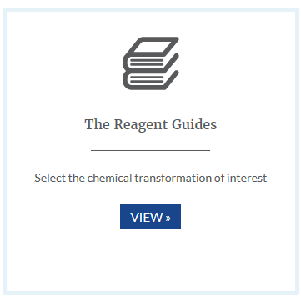
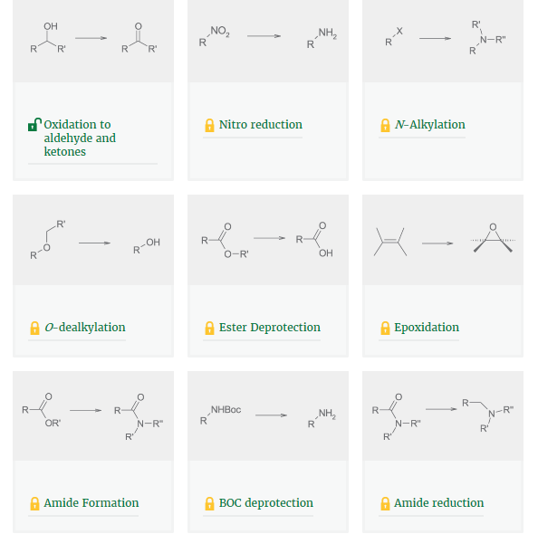
Reagent Guides Available Now!
How to access the guides:
www.reagentguides.com
- Free registration!
“Check out the reagents guides to help drive greener process development”
Any questions or comments? Contact Shaun Hughes or Barry Dillon

